Slide 1
BTP Endsem Evaluation
Supervised by -
Dr. Asif Ekbal
Associate Professor
Department of CSE
IIT Patna
Name - Saurav Dudhate
Roll No - 2001CS62

Slide 2
Problem Definition
The main goal is to develop Conversational Agents with Persuasion and Negotiation Abilities.
3 aspects :
Persuasion
Influencing
Negotiation

Slide 3
Work Done
Evaluation of LLMs in various kinds of conversational setups
Creation of test set out of dataset selected
Generating 50 zero-shot, one-shot and few-shot prompts
Evaluation based on various scores such as METEOR, BLEU, ROUGE, BERTScore
Human evaluation of prompts based on various factors
Influencing component of the model :
Creation a set of communication flows in order to make a blueprint for dataset generation
Generation of dataset on basis of these communication flows using LLMs
Running codes for the influencing module

Slide 4
Literature Survey
Empathetic Persuasion : Reinforcing empathy and persuasion in Dialogue Systems
Deep Reinforcement Learning for Dialogue Generation
Open AI lectures on Prompting
TOD Lectures by Princeton

Slide 5
Datasets
Persuasion for Good dataset :
1017 human to human conversations for charity named Save the Children
Annotation done using 32 emotion labels, with the use of Emphatetic Dialogues dataset.

Slide 6
Methodology
Creation of test set
Human like responses excluded
Variety of conversations included : Mathematical figures, Logical Reasoning
3 or 5 dialogues from extracted from conversation depending on bot response
Prompt length restricted upto 256 tokens for zero shot and 512 tokens for one and few shot

Slide 7
Methodology
15 test samples per test set
All context-response pairs correspond to similar generated response type
Zero shot - 1 context, create a response
One shot - 1 context-response pair, 1 context, create a response
N shot - N context-response pair, 1 context, create a response
Test for following models :
Alpaca
Falcon
Llama

Slide 8
Methodology
Human Evaluation :
Generic Metrics :
Fluency
Non-repetitiveness
Correctness / Context relevance
Task-specific Metrics :
Politeness
Empathy
Assigned scores from 1-5

Slide 9
Methodology
Automatic Evaluation :
BLEU Scores
METEOR Scores
ROUGE Scores
BERT Scores
Embedding Average
Vector Extrema
Greedy Matching

Slide 10
Results
https://docs.google.com/spreadsheets/d/1xYEehowwxfH6T1dOosMNJ9uGInPxHizsIPsYxhkFKMw/edit?usp=sharing

Slide 11
 | Zero-shot | One-shot | Two-shot
Bleu 1 | 0.060254 | 0.073916 | 0.068778
Bleu 2 | 0.016737 | 0.024656 | 0.019678
Bleu 3 | 0.007238 | 0.010158 | 0.007978
Bleu 4 | 0.003832 | 0.005016 | 0.003637
METEOR | 0.048444 | 0.051008 | 0.038142
ROUGE_L | 0.052981 | 0.060195 | 0.048614
BERTScore | 0.8086200356 | 0.8111463189 | 0.799346447
EmbeddingAverageCosineSimilarity | 0.754511 | 0.743256 | 0.642455
VectorExtremaCosineSimilarity | 0.389199 | 0.392213 | 0.387520
GreedyMatchingScore | 0.706590 | 0.714014 | 0.695073

Slide 12
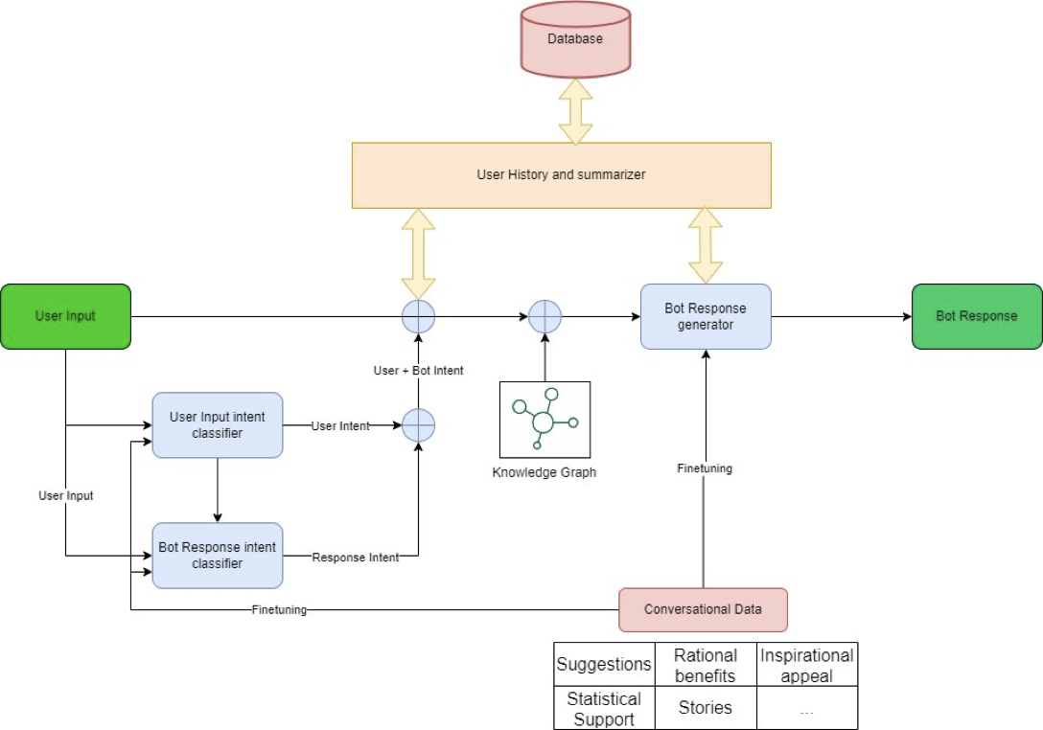
Architecture

Slide 13
Reward Functions
R_total = ∑[For all support_types] (w_i * R_i) + w_diversity * D
∑[i in support_types] (w_i * R_i) s the sum of rewards for each support type, weighted by their importance.
w_diversity is the weight assigned to the diversity reward.
D is the diversity score, which measures how evenly the agent uses different support types.
w_i depends on persona and compliance rate
Inspirational appeal: 0.9
Rational benefits: 0.5
Statistical Support: 0.7
Stories Support: 0.7

Slide 14
Example of Communication Flow
In 1st conversation, User says hello, a suggestion is introduced, user is interested, asks bot about further details and says will get back. \
In 2nd conversation, user says it is happy with the suggestion but puts forth certain questions as in FAQs, the bot clarifies and the conversations ends with user satisfied. \
In 3rd conversation, the user is convinced with the given suggestion but wants to look for a couple of additional features, the bot provides the same. \
In 4th conversation, the user checks out the other suggestion and holds another series of queries with the bot.\
In 5th conversation, the user thanks the bot for the help. \

Slide 15
Future Works
Working on adding the rewards :
Rewards:
Change in opinion/Sentiment
doubtful -> hopeful;
neutral=> not influenced
Curious/Open/Action
Length of response
Ease of answering
Information flow
Semantic coherence
Inclusion of knowledge graphs

